Slide 1
Advanced CPT (Java)
240-321, Semester 2, 2004-2005
6. Strings
(Chapter 10, D&D)
Objectives
  to look at the String, StringBuffer, Character, and StringTokeniser classes

Slide 2
Contents
1. The String Class
2. The StringBuffer Class
3. The Character Class
4. The StringTokeniser Class
5. Regular Expressions

Slide 3
1. The String Class
The inner parts of a string cannot be changed once they have been initialised
  e.g. abbc --> addc is not allowed
But new things can be added to the end of a string object.
Also a string object can be changed by assigning it a new string.

Slide 4
1.1. Creating a String Object
Four different ways
(there are more).
String color = “blue";
String s1;
s1 = new String(“hello ”);
char chs[] = {‘a’, ‘n’, ‘d’, ‘y’};
String s2 = new String(chs);
s1 = s1 + s2 + “ davison”;
// + is string concatenation
1
2
3
4

Slide 5
1.2. Comparing Strings
0
9
A
Z
a
z
0
48
57
65
90
97
122
s1.equals(s2)
  lexicographical comparison
  returns true if s1 and s2 contain the same text
s1 == s2
  returns true if s1 and s2 refer to the same object
continued

Slide 6
s1.compareTo(s2)
  returns 0 if s1 and s2 are equal
  returns < 0 if s1 < s2; > 0 if s1 > s2
s1.startsWith(“text”)
  returns true if s1 starts with “text”
s1.endsWith(“text”)
  returns true if s1 ends with “text”

Slide 7
1.3. Locating Things in Strings
for text analysis
s1.indexOf(‘c’)
  returns index position of first ‘c’ in s1, otherwise -1
s1.lastIndexOf(‘c’)
  returns index position of last ‘c’ in s1, otherwise -1
Both of these can also take string arguments:
  s1.indexOf(“text”)

Slide 8
1.4. Extracting Substrings
s1.substring(5)
  returns the substring starting at index position 5
s1.substring(1, 4)
  returns substring between positions 1 and 3
  note: second argument is end position + 1

Slide 9
1.5. Changing Strings
s1.replace(‘a’, ‘d’)
  return a new string; replace every ‘a’ by ‘d’
s1.toLowerCase()
  return a new string where every char has been converted to lowercase
s1.trim()
  return a new string where any white space before or after the s1 text has been removed

Slide 10
1.7. Other String Methods
The String class is in the java.lang package
  there are many more String methods!
  e.g. s.length()
Look at the Java documentation for the String class:

Slide 11
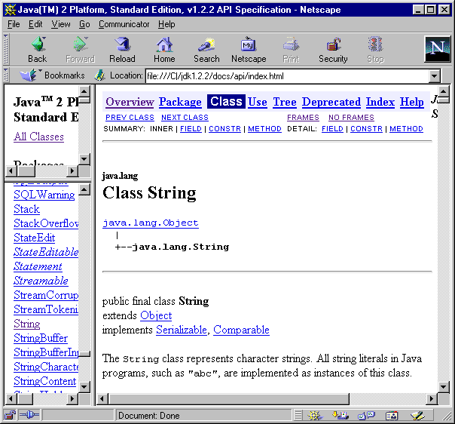

Slide 12
2. The StringBuffer Class
Objects of the StringBuffer class can change their inner text
  used when changing a string by creating a new string is too slow
    not often a problem

Slide 13
2.1. Creating a StringBuffer Object
Three different ways
(there are more).
StringBuffer buf1 =
new StringBuffer(“hello”);
StringBuffer buf2 =
new StringBuffer(10);
StringBuffer buf3 =
new StringBuffer();
Just a starting
value, the size
can dynamically
increase.

Slide 14
2.2. StringBuffer Methods
buf1.length()
  returns the length of the text in buf1
  many String methods are also available in StringBuffer
buf1.toString()
  return the text as a String
continued

Slide 15
buf1.append(“hello”)
  appends “hello” to the end of buf1
  append() can take many types of arguments: int, char, float, etc.
buf1.insert(5, “hello”)
  inserts “hello” at index position 5
  insert() can take many types of data argument
modify
buf1

Slide 16
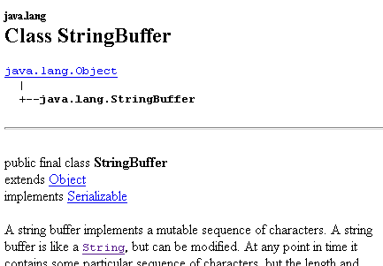
2.3. Other StringBuffer Methods
Look at the StringBuffer documentation.

Slide 17
3. The Character Class
Java provides the familiar primitive data types:
  int, float, char, etc.
It also provides class equivalents:
  Integer, Float, Character, etc
  called type wrappers
continued

Slide 18
The type wrapper classes can be used to create objects (e.g. a Character object) which can be manipulated like other Java objects.
Most Character class methods are static
  that means that the methods are called using the class name

Slide 19
3.1. Character Static Methods
Character.isDigit(c)
// is c a digit?
Character.isLetter(c)
// is c a letter?
Character.isLowerCase(c)
// is c lowercase?
Think of Character as a library of
useful methods related to chars

Slide 20
3.2. Creating a Character Object
Character c1;
c1 = new Character(‘A’);
Compare with:
  char c2 = ‘A’;
There are many more Character methods
  see the documentation

Slide 21
4. The StringTokeniser Class
This class provides a way of separating a string into tokens
  e.g. “hello andrew davison”
  becomes three tokens:
  “hello” “andrew” “davison”
Very useful for parsing
  dividing a program into tokens representing variables, constants, keywords, numbers, etc.

Slide 22
4.1. The Basic Technique
A String is converted to StringTokenizer, and then the tokens are removed one at a time inside a loop:
  String token:
  StringTokenizer st =
  new StringTokenizer(
  “...the string ...”);
  while ( st.hasMoreTokens() ) {
  token = st.nextToken();
  : // do something with token
  }
continued

Slide 23
StringTokenizer st =
new StringTokenizer(...)
  creates a sequence of tokens from the string
  the default separators are "\n\t\r "
  (newline, tab, carriage return, space)
  the separators can be changed
st.hasMoreTokens()
  test if there are any more tokens left
st.nextToken()
  returns the next token as a String object

Slide 24
4.2. TokenTest.java
import java.util.*; // StringTokenizer class
import javax.swing.JOptionPane;
public class TokenTest {
public static void main(String args[])
{
String str = JOptionPane.showInputDialog(
"Enter a string:");
String output;
StringTokenizer tokens =
new StringTokenizer( str );
:

Slide 25
output = "Number of elements: " +
tokens.countTokens() +
"\nThe tokens are:\n" ;
while ( tokens.hasMoreTokens() )
output += tokens.nextToken() + "\n" ;
JOptionPane.showMessageDialog(null, output,
"Token Test Results",
JOptionPane.INFORMATION_MESSAGE);
System.exit(0);
} // end of main()
} //end of TokenTest

Slide 26
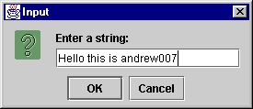
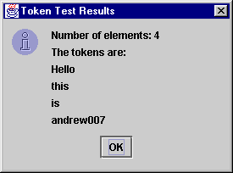
Use

Slide 27
Notes
tokens.countTokens()
  returns the total number of tokens
  use before tokens are removed from the token sequence with nextToken()

Slide 28
5. Regular Expressions
A regular expression is a text pattern.
The java.util.regex package contains several classes that allow you to compare strings to regular expressions to see if they match.
  matching strings can be changed/replaced after being found
continued

Slide 29
Java uses the regular expression notation from the Perl language
  easy to learn (if you already know Perl)
This feature was introduced in J2SE 1.4, so it's not explained in older textbooks.
continued

Slide 30
A good place to learn about regular expressions and their use in Java:
  Linux Magazine
  July 2002
  a special issue on regular expressions
  we have a copy in our library
    or see me for copies of the magazine's articles

Slide 31
Find Matches in a String
import java.util.regex.*;
public class BasicMatch
{
public static void main(String[] args)
{
// Compile regular expression
String patternStr = "b";
Pattern pattern =
Pattern.compile(patternStr);
:

Slide 32
// Determine if pattern exists in input
String inputStr = "a b c b";
Matcher matcher = pattern.matcher(inputStr);
boolean matchFound = matcher.find(); //true
// Get matching string
String match = matcher.group(); // "b"
// Get indices of matching string
int start = matcher.start(); // 2
int end = matcher.end(); // 3
// end is index of last matching char + 1
// Find the next occurrence
matchFound = matcher.find(); // true
}
}

Slide 33
Search and Replace
import java.util.regex.*;
public class BasicReplace
{
public static void main(String[] args)
{ String inputStr = "a b c a b c";
String patternStr = "a";
String replacementStr = "x";
// Compile regular expression
Pattern pattern =
Pattern.compile(patternStr);
:

Slide 34
// Replace all occurrences of
// pattern in input
Matcher matcher =
pattern.matcher(inputStr);
String output =
matcher.replaceAll(replacementStr);
// makes "x b c x b c"
}
}

